Slide 1



21AIE211 Introduction to COMPUTER NETWORKS
2-0-3 3

Slide 2
APPLICATION LAYER
Conceptual, implementation aspects of network application protocols
Transport-layer service models
client-server paradigm
peer-to-peer paradigm
Learn about protocols by examining popular application-level protocols
HTTP
FTP
SMTP / POP3 / IMAP
DNS

Slide 3
Network applications: some jargon
Process: program running within a host.
within same host, two processes communicate using interprocess communication (defined by OS).
processes running in different hosts communicate with an application-layer protocol
User agent: interfaces with user “above” and network “below”.
implements user interface & application-level protocol
Web: browser
E-mail: mail reader
streaming audio/video: media player

Slide 4
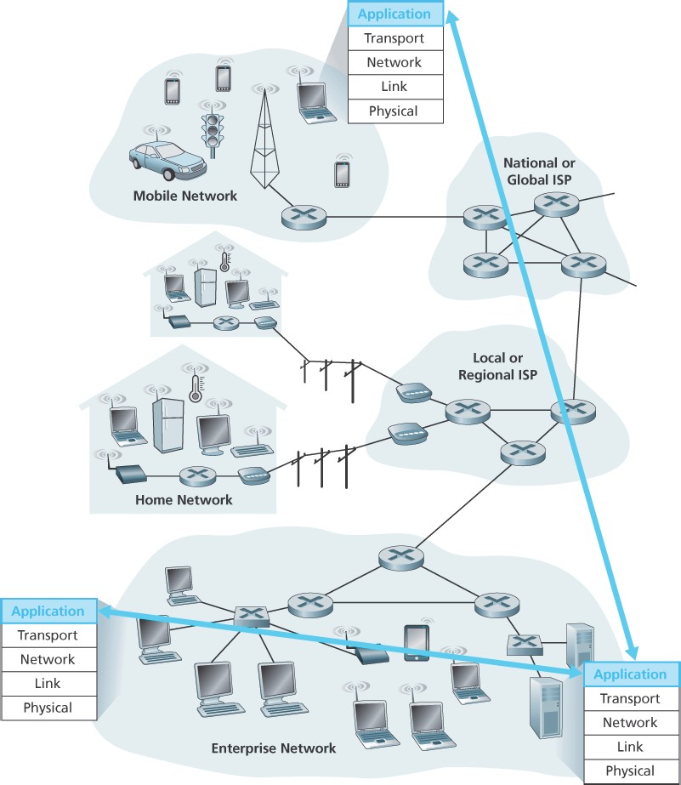
Applications and application-layer protocols
Application: communicating, distributed
processes
e.g., e-mail, Web, P2P file sharing, instant messaging
running in end systems (hosts)
exchange messages to implement application
Application-layer protocols
one “piece” of an app
define messages exchanged by apps and actions
taken
use communication services provided by lower layer protocols (TCP, UDP)

Slide 5
Application-layer protocol defines
Types of messages exchanged, e.g., request & response messages
Syntax of message types: what fields in messages & how fields are delineated
Semantics of the fields, i.e., meaning of information in fields
Rules for when and how processes send & respond to messages
Public-domain protocols:
defined in RFCs
allows for interoperability
eg, HTTP, SMTP Proprietary protocols:
eg, KaZaA

Slide 6

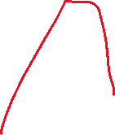



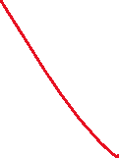


Network Application Architectures
Types
Client Server Application
Peer- to Peer Architecture
Client Server Application : There is an always-on host, called the server, which services requests
Eg : Web application for which an always-on Web server services requests from browsers running on client hosts.any other hosts, called clients.-Web, FTP, Telnet, and e-mail
Clients do not directly communicate with each other
Server has a fixed, well-known address, called an IP address
Server is always on, a client can always contact the server by sending a packet to the server’s IP address.
Often in a client-server application, a single-server host is incapable of keeping up with all the requests from clients most popular Internet services—such as search engines (e.g., Google, Bing, Baidu), Internet commerce (e.g., Amazon, eBay, Alibaba), Web based e-mail (e.g., Gmail and Yahoo Mail), social networking (e.g.,. Facebook, Instagram, Twitter, and WeChat) .
Hence data center, housing a large number of hosts, is often used to create a powerful virtual server
application’s architecture is distinctly different from the network architecture. It dictates how the application is structured over the various end systems.

Slide 7
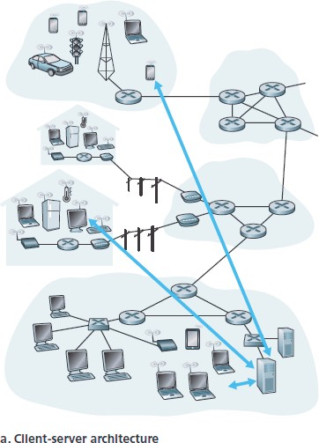
Client-server paradigm
Typical network app has two pieces: client and server
Client:
initiates contact with server
(“speaks first”)
typically requests service from
server,
Web: client implemented in browser; e-mail: in mail reader
Server:
provides requested service to client
e.g., Web server sends requested Web
page, mail server delivers e-mail

Slide 8
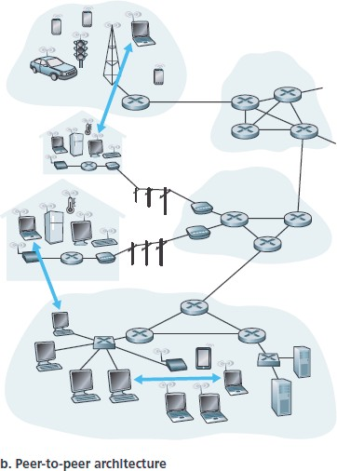



Peer to Peer Architecture
There is minimal (or no) reliance on dedicated servers in data centers. Instead the application exploits direct communication between pairs of intermittently connected hosts, called peers
peers. The peers are not owned by the service provider, but
are instead desktops and laptops controlled by users
Eg: file sharing (e.g., BitTorrent), peer-assisted download acceleration (e.g., Xunlei), and Internet telephony and video conference (e.g., Skype).
One of the most compelling features of P2P architectures is
their self-scalability
Some applications have hybrid architectures, combining both client-server and P2P elements

Slide 9
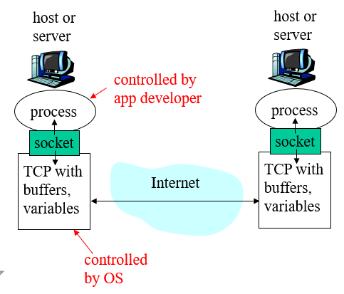
Processes communicating across network- how the programs, running in multiple end systems, communicate with each other.
In the context of a communication session between a pair of processes, the process that initiates the communication (that is, initially contacts the other process at the beginning of the session) is labeled as the client. The process that waits to be contacted to begin the session is the server.
A process sends messages into, and receives messages from, the network through a software interface called a socket
socket is analogous to door
sending process shoves message out door
sending process assumes transport infrastructure
on other side of door which brings message to
socket at receiving process
API: (1) choice of transport protocol; (2) ability to fix a few parameters (lots more on this later)
The application developer has control of everything on the application layer side of the socket but has little control of the transport-layer side of the socket.
The only control that the application developer has on the transport-layer side is
the choice of transport protocol and
perhaps the ability to fix a few transport-layer parameters such as maximum buffer and
maximum segment sizes

Slide 10

Addressing processes:
For a process to receive messages, it must have an identifier
Every host has a unique 32-bit IP address
Q: does the IP address of the host on which the process runs suffice for identifying the process?
Answer: No, many processes can be running on same host
Identifier includes both the IP address and port numbers associated with the process on the host.
Example port numbers:
HTTP server: 80
Mail server: 25
More on this later

Slide 11










Transport Services Available to Applications
socket is The application at the sending side pushes messages through the socket. At the other side of the socket, the transport-layer protocol has the responsibility of getting the messages to the socket of the receiving process interface between the application process and the transport-layer protocol.
Classify the possible services along four dimensions:
Reliable data transfer,
Throughput,
Timing,
Security.

Slide 12
Reliable Data Transfer
something has to be done to guarantee that the data sent by one end of the application is delivered correctly and completely to the other end of the application. If a protocol provides such a guaranteed data delivery service, it is said to provide reliable data transfer
When a transport protocol provides this service, the sending process can just pass its data into the socket and know with complete confidence that the data will arrive without errors at the receiving process
When a transport-layer protocol doesn’t provide reliable data transfer, some of the data sent by the sending process may never arrive at the receiving process. This may be acceptable for loss-tolerant applications, most notably multimedia applications such as conversational audio/video that can tolerate some amount of data loss. In these multimedia applications, lost data might result in a small glitch in the audio/video—not a crucial impairment.
Timing
Guarantee that every bit that the sender pumps into the socket arrives at the receiver’s socket no
more than 100 msec later.
Such a service would be appealing to interactive real-time applications, such as Internet telephony, virtual environments, teleconferencing, and multiplayer games, all of which require tight timing constraints on data delivery in order to be effective

Slide 13
Throughput
In the context of a communication session between two processes along a network path, is the rate at
which the sending process can deliver bits to the receiving process.
Because other sessions will be sharing the bandwidth along the network path, and because these other sessions will be coming and going, the available throughput can fluctuate with time.
service that a transport layer protocol could provide, namely, guaranteed available throughput at some
specified rate. With such a service, the application could request a guaranteed throughput of r bits/sec,
Applications that have throughput requirements are said to be bandwidth-sensitive applications
Security
In the sending host, a transport protocol can encrypt all data transmitted by the sending process, and in the receiving host, the transport-layer protocol can decrypt the data before delivering the data to the receiving process

Slide 14
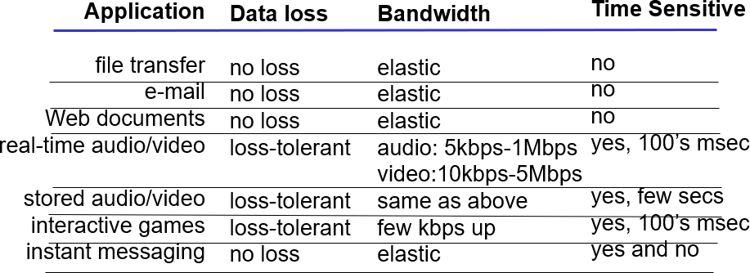
Transport service requirements of common apps

Slide 15
Internet transport protocols services
TCP service:
connection-oriented: setup required between client and server processes
reliable transport between sending and receiving process
flow control: sender won’t overwhelm receiver
congestion control: throttle sender when network overloaded
Encryption: TCP-enhanced-with-SSL
Reliable data transfer service
no bandwidth or delay guarantees
UDP service:
unreliable data transfer between sending and receiving process
does not provide: connection setup, reliability, flow control,
congestion control, timing, or bandwidth guarantee
Q: why bother? Why is there a UDP?

Slide 16
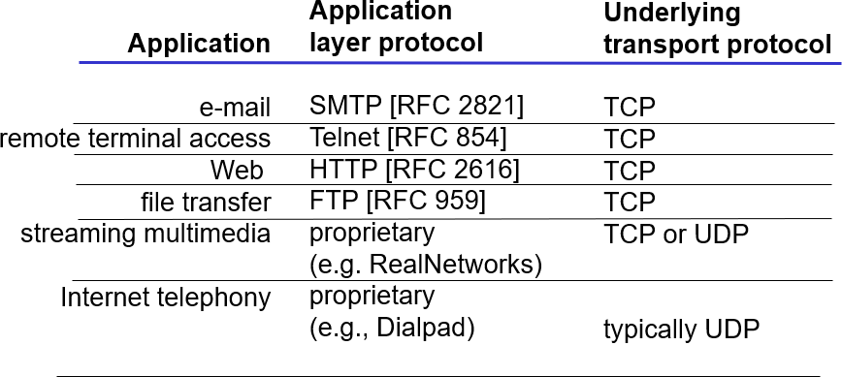
Internet apps: application, transport protocols

Slide 17
Web and HTTP

Slide 18
Web and HTTP
Web page consists of objects
Object can be HTML file, JPEG image, Java applet, audio file,…
Web page consists of base HTML-file which includes several referenced objects
Each object is addressable by a URL
Example URL:
www.someschool.edu/someDept/pic.gif
host name path name
When a user requests a Web page (for example, clicks on a hyperlink), the browser sends HTTP request messages
for the objects in the page to the web server.
The server receives the requests and responds with HTTP response messages that contain the objects.

Slide 19
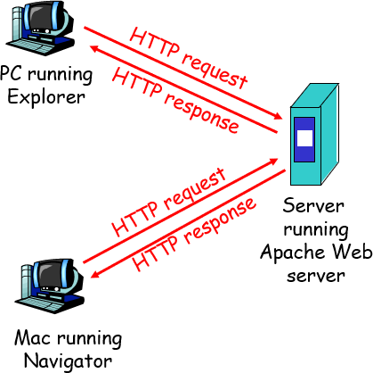
HTTP overview
HTTP: hypertext transfer protocol
Web’s application layer protocol
client/server model
client: browser that requests, receives,
“displays” Web objects
server: Web server sends objects in response to requests
HTTP 1.0: RFC 1945
HTTP 1.1: RFC 2616
HTTP is implemented in two programs: a client program and a server program.
The client program and server program, executing on different end systems, talk to each other by exchanging HTTP
messages.
HTTP defines the structure of these messages and how the client and server exchange the messages

Slide 20
HTTP overview (continued)
Uses TCP:
client initiates TCP connection (creates socket) to server, port 80
server accepts TCP connection from client
HTTP messages (application-layer protocol messages) exchanged between browser (HTTP client) and Web server (HTTP server)
TCP provides a reliable data transfer service to HTTP
TCP connection closed
HTTP is “stateless”
server maintains no information about past client requests
Protocols that maintain “state” are
complex!
past history (state) must be maintained
if server/client crashes, their views of “state” may be inconsistent, must be reconciled

Slide 21
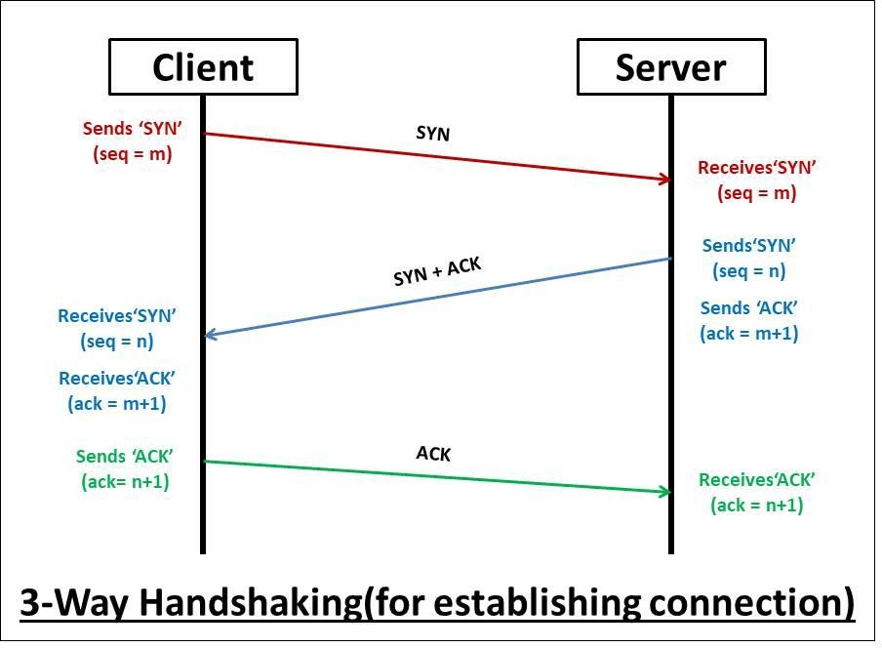
TCP 3-way Handshaking
SYN Flag: SYN stands for synchronization. It can be described as a request for establishing a connection. If SYN is 1, it means that the device wants to establish a secure connection, else not.
ACK Flag: ACK stands for acknowledgement. It can be described as the response of SYN. If ACK is 1, the device has received the SYN message and acknowledges it, else not.
Sequence Number:Generally, a sequence number is used only once in one connection. For other data transmission in the same connection, some other random sequence number can be used.
Acknowledgement Number: It is the next sequence number that the acknowledgement sending device expects from the sender.
HTTP need not worry about lost data or the details of how TCP recovers from loss or reordering of data within the network. That is the job of TCP and the protocols in the lower layers of the protocol stack.

Slide 22
HTTP connections
Nonpersistent HTTP
At most one object is sent over a TCP connection.
HTTP/1.0 uses nonpersistent HTTP
Persistent HTTP
Multiple objects can be sent over single TCP connection between client and server.
HTTP/1.1 uses persistent connections
in default mode
In many Internet applications when client-server interaction take place over TCP, for an extended period of time with a series of requests that may be made back-to-back, periodically at regular intervals, or intermittently the application developer needs to make an important decision—
should each request/response pair be sent over a separate TCP connection,-non-persistent connections; or
should all of the requests and their corresponding responses be sent over the same TCP connection-
persistent connections

Slide 23
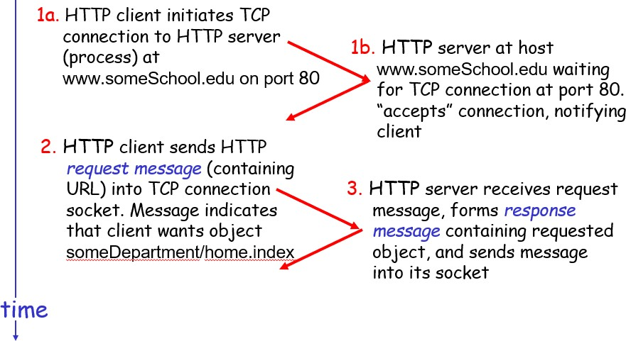
Nonpersistent HTTP
Suppose user enters URL
suppose the page consists of a base HTML file and 10 JPEG images, and that all 11 of these objects reside on the same server
www.someSchool.edu/someDepartment/home.index

Slide 24
Nonpersistent HTTP (cont.)
4. HTTP server closes TCP
connection.
5. HTTP client receives response message containing html file, displays html. Parsing html file, finds 10 referenced jpeg objects
time
6. Steps 1-5 repeated for each
of 10 jpeg objects
Users can configure modern browsers to control the degree of parallelism. default modes, most browsers open 5 to 10 parallel TCP connections, and each of these connections handles one request-response transaction (some of the JPEGs are obtained over parallel TCP connections.)

Slide 25
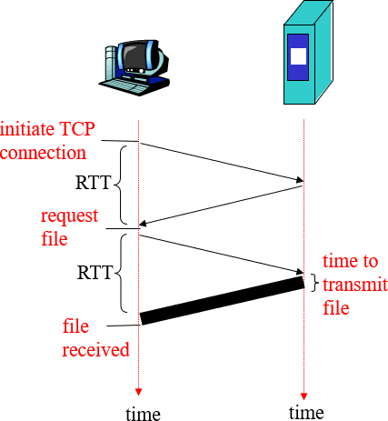
Response time modeling
Definition of round-trip time (RTT),: time to send a small
packet to travel from client to server and back.
Response time:
one RTT to initiate TCP connection
this involves a “three-way handshake”—the client sends a small TCP segment to the server, the
server acknowledges and responds with a small TCP segment, and, finally, the client acknowledges back to the server.
The first two parts of the three-way handshake take
one RTT
the client sends the HTTP request message
combined with the third part of the three-way
handshake (the acknowledgment) into the TCP
connection
one RTT for HTTP request and first few bytes of HTTP
response to return
file transmission time
total = 2RTT+transmit time
The RTT includes packet-propagation delays, packet queuing delays in intermediate routers and switches, and packet-processing delays

Slide 26
Persistent HTTP
Nonpersistent HTTP issues:
requires 2 RTTs per object
OS must work and allocate host resources for each TCP connection
but browsers often open parallel TCP
connections to fetch referenced objects
Persistent HTTP
Server leaves connection open after sending response
Multiple Web pages residing on the same server can be sent from the server to the same client over a single persistent TCP connection.
Typically, the HTTP server closes a connection when it isn’t used for a certain time (a configurable timeout interval).
Persistent without pipelining:
client issues new request only when previous response has been received
one RTT for each referenced object
Persistent with pipelining:
default in HTTP/1.1
client sends requests as soon as it encounters a referenced object
as little as one RTT for all the referenced objects
recently, HTTP/2 [RFC 7540] builds on HTTP
1.1 by allowing multiple requests and replies to be interleaved in the same connection, and a mechanism for prioritizing HTTP message requests and replies within this connection

Slide 27
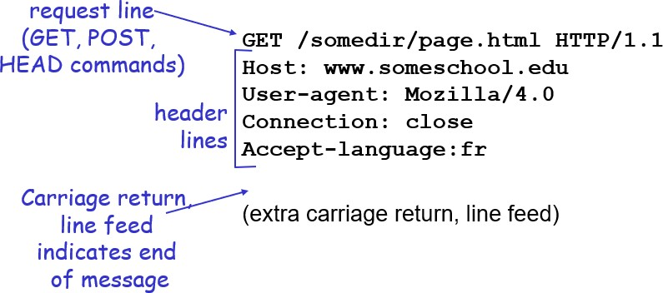
HTTP request message
Connection: close header line, the browser is telling the server that it doesn’t want to bother with persistent connections; it wants the server to close the connection after sending the requested object
The Useragent:
header line specifies the user agent, that is, the browser type that is making the request to the server.
Accept-language: header indicates that
the user prefers to receive a French version of the object, if such an object exists on the server
The method field can take on several different values, including GET, POST, HEAD, PUT, and DELETE . The great majority of HTTP request messages use the GET method. The GET method is used when the browser requests an object, with the requested object identified in the URL field.
An HTTP client often uses the POST method when the user fills out a form—for example, when a user provides
search words to a search engine
two types of HTTP messages: request, response
HTTP request message:
ASCII (human-readable format)

Slide 28
HTTP request message
The HEAD method is similar to the GET method. When a server receives a request with the HEAD method, it responds with an HTTP message but it leaves out the requested object. Application developers often use the HEAD method for debugging.
The PUT method is often used in conjunction with Web publishing tools. It allows a user to upload an object to a specific path (directory) on a specific Web server. The PUT method is also used by applications that need to upload objects to Web servers.
The DELETE method allows a user, or an application, to delete an object on a Web
server.
Uses GET method : Input is uploaded in URL field of request line: www.somesite.com/animalsearch?monkeys&ban ana

Slide 29
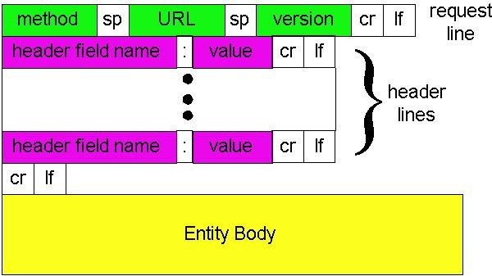






HTTP request message: general format

Slide 30
Method types
HTTP/1.0
GET
POST
HEAD
asks server to leave requested object out of response
HTTP/1.1
GET, POST, HEAD
PUT
uploads file in entity body to path specified in URL field
DELETE
deletes file specified in the
URL field

Slide 31
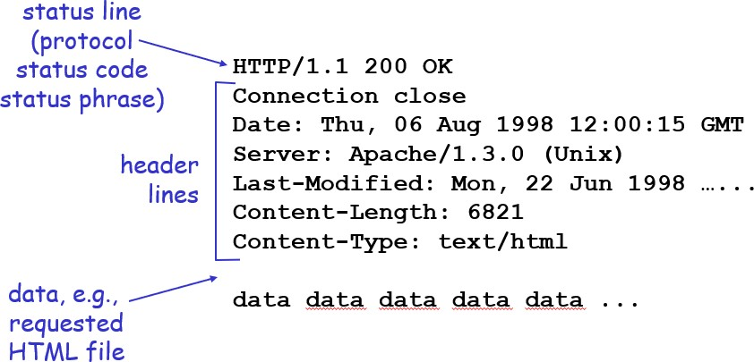
HTTP response message

Slide 32
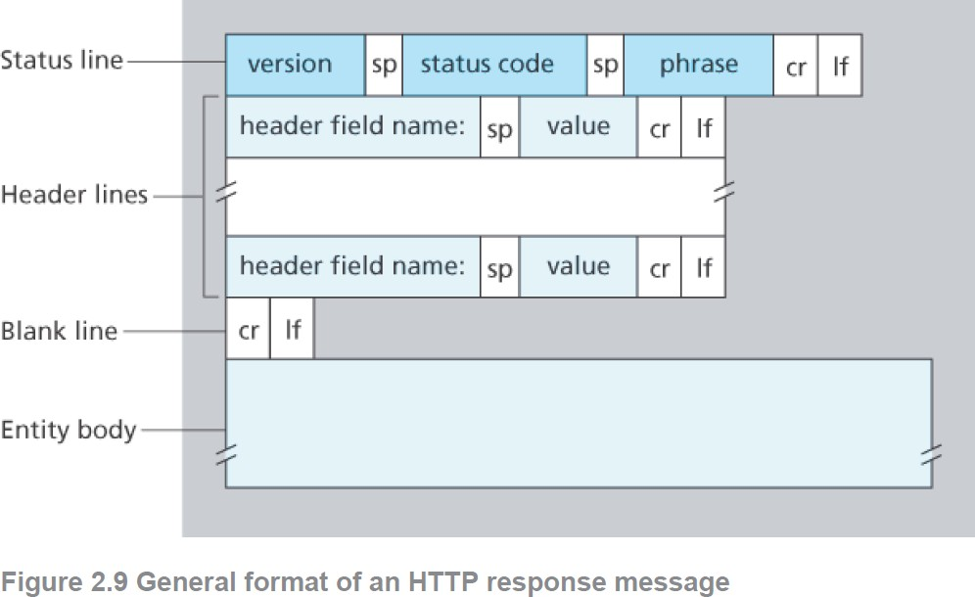
HTTP response message

Slide 33
HTTP response status codes
In first line in server->client response message. -The status code and associated phrase
A few sample codes:
200 OK
request succeeded, requested object later in this
message
301 Moved Permanently
requested object moved, new location specified later in this message (Location:)
400 Bad Request
request message not understood by server
404 Not Found
requested document not found on this server
505 HTTP Version Not Supported

